Slide 1
Grant Writing Tips for K-12 Educators Unlocking Funding Opportunities for Your Classroom
Michelle Leftwich, Director of Federal Programs
Raleigh County Schools

Slide 2
Introduction
Welcome to the Grant Writing Tips presentation!
Learn how to secure funding for your classroom projects.
Discover effective strategies for successful grant applications.

Slide 3
Why Grants matter
Grants provide resources beyond the school budget.
They enable innovative projects and enhance student experiences.
Grants can help bridge the gap between your vision and available funds.

Slide 4
Crafting a compelling proposal
Follow these steps

Slide 5
Part One
Summary
Gives a brief overview of the entire proposal and provides the reader with a context for understanding all other sections. It prepares the reader to review the proposal.
Introduction
Describes the organization that is asking for the money. Explains it’s mission and services, demonstrates credibility, and shows its qualifications for tackling the problem.

Slide 6
Example:
We seek funding to implement a comprehensive digital literacy program aimed at empowering underserved youth in our community with essential technology skills.
The program will address the growing digital divide by providing access to modern technology resources, fostering digital competency, and promoting the responsible use of technology.
Clear Project Description:
--Clearly state your project’s purpose and expected outcomes.
--Explain how it aligns with curriculum/program and student needs

Slide 7
PART TWO
Problem
Describes the situation motivating the applicant to seek a grant. Explains why the situation matters and what’s causing it.
Outcomes
Specifies the measurable improvements that the proposed program/project will produce in the situation described in the Problem Section.

Slide 8
Impact and Benefits
--Describe how the project will benefit students and the community.
--Highlight potential long-term outcomes and positive changes.
Example:
Through a series of workshops, hands-on training, and mentorship, this project aims to equip participants with the skills needed to thrive in an increasingly digital world.

Slide 9
Problem
Three Primary Questions to Ask:
What is motivating you to take on this action?
What is the significance?
What are the causes?
Depending on the funder the problem may also be called a need statement, a needs assessment, a problem statement, or a situational analysis.

Slide 10
OUTCOMES
Program Outcomes are concise statements that answer the following questions:
Who or what will change?
How many?
How much change will take place?
What type of change?
When will the change occur?

Slide 11
Measurable Objectives
--Define clear and measurable goals for the project.
--Explain how you will assess the project's success.
Example:
Deliver a series of structured workshops focused on fundamental digital skills, including computer operation, internet navigation, online communication, and basic software proficiency.
After attending the program activities, the participants will demonstrate a 75% increase in improved digital literacy skills, as measured through pre- and post-assessments.

Slide 12
PART Three
Methods
Responds to the problem’s causes. Justifies the choice of the approach and presents a detailed plan for program implementation.
Evaluation
Describes how the applicant will assess whether the program activities are proceeding as planned and are producing the expected results.
Notes:
The evaluation section describes how your organization will access whether the program is operating according to plan and achieving the intended outcomes.
The two parts of the evaluation – outcome evaluation and process evaluation.
Outcome evaluation measures results - how much change did your program produce.
Process evaluation examines the methods used and whether the program is operating according to plan.
Before you design the evaluation, you must have clear, measurable and achievable program outcomes.

Slide 13
Innovative Approach
--Showcase how your project stands out from the rest.
--Highlight creative teaching methods and engaging activities.
Example:
Design a curriculum in collaboration with experienced educators and industry professionals, ensuring its relevance and effectiveness.
Organize field trips to local tech companies and institutions, exposing participants to real-world tech environments.

Slide 14
Collaboration
--Emphasize partnerships with other educators, schools, or community organizations.
--Demonstrate a collective effort to enhance project impact.
Example:
Collaborate with local schools, community centers, and non-profit organizations to identify and enroll underserved youth aged 14-18.
Provide mentorship opportunities by partnering participants with tech-savvy volunteers who can offer guidance and support.

Slide 15
Evaluation
What will be measured?
What’s the baseline?
What information will be collected?
How will information be collected?
Who will collect the information?
How will the data be analyzed?
What reports will be produced when, and how will they be used?
Notes:
The evaluation section describes how your organization will access whether the program is operating according to plan and achieving the intended outcomes.
The two parts of the evaluation – outcome evaluation and process evaluation.
Outcome evaluation measures results - how much change did your program produce.
Process evaluation examines the methods used and whether the program is operating according to plan.
Before you design the evaluation, you must have clear, measurable and achievable program outcomes.

Slide 16
PART FOUR
Budget
Outlines expenses to be provided by the funder and the resources to be provided by the applicant or others. Shows how expenses are calculated and often provides a written justification for each expense. The budget tells the same story as the Methods Section, but in the language of dollars.
Future Support
Describes the strategy for sustaining the program or its positive benefits after grant funding ends. Shows why the requested funding is a good investment.

Slide 17
Budget Breakdown
--Provide a detailed budget for materials, resources, and any other expenses.
--Justify each expense and show how it supports project success.
--Explain where other cash and in-kind resources will come from and if these are anticipated or secured.
--Follow the funder’s direction exactly.
Example:
Technology Resources: Computers, software licenses, and internet access for workshops.
Workshop Materials: Handouts, textbooks, and other educational resources.
Field Trips: Transportation, entrance fees, and guided tours of tech facilities.
Workshop Presenters: Education Consultant-Tech (fees and travel, in-kind)

Slide 18
Future Support
Sustainability
--Explain how the project will continue after the grant period.
--Outline plans for ongoing funding or integration into the curriculum.
Example:
Upon completion of the initial grant-funded project, we intend to seek additional funding from local businesses, foundations, and government agencies to sustain and expand the program. Additionally, we will explore partnerships with educational institutions and tech companies to ensure ongoing support and resources.

Slide 19
Writing tips
Be concise and clear in your writing.
Avoid jargon and complex language.
Proofread for grammar and spelling errors.

Slide 20
FINDING FUNDERS

Slide 21
Grant Prospecting
Does your organization have a clear mission statement and/or program idea?
What type of funding do you need?
Search for grant makers whose focus/priority areas align with your mission.
Does the grant maker cover your geographic area and/or demographics?
Join your local civic association, business networking group, or nonprofit association
Use free resources such as grants.gov

Slide 22
BAF Students First Mini Grant
https://www.bafwv.org/students-first-grants.html#
Last year’s awards totaled $28,278.
Mission Statement: Beckley Area Foundation exists to inspire and facilitate generous charitable giving that advances our community.
Notes:
Information about the grant
Innovative
Creative
Project-based
BAF website BAFWV.org

Slide 23
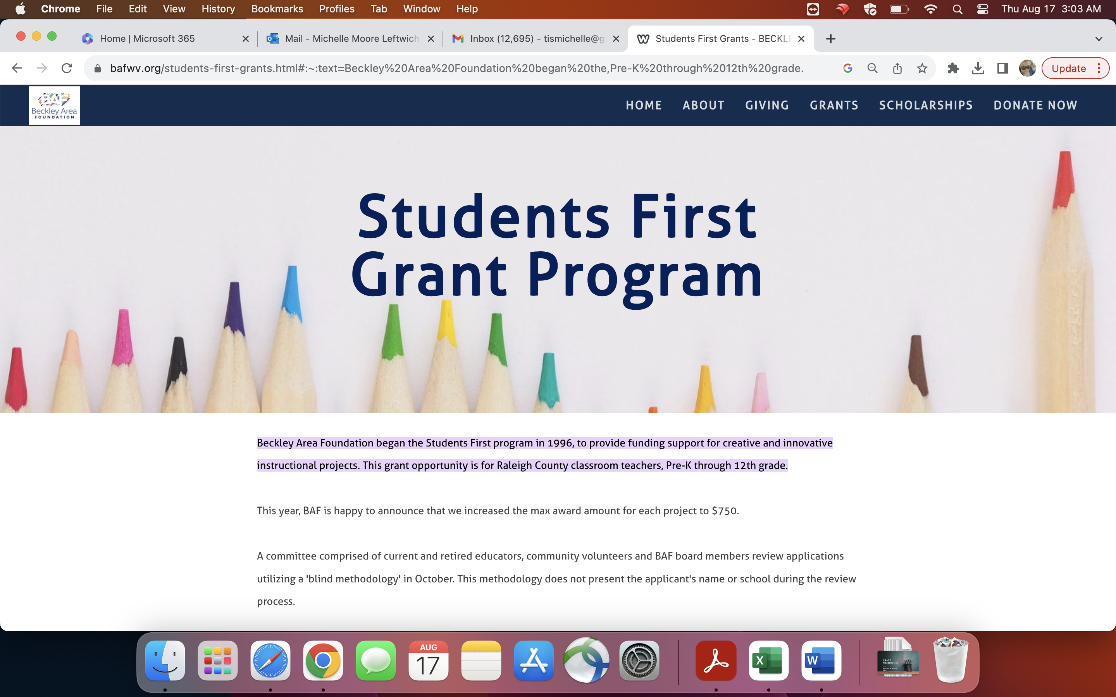

Slide 24
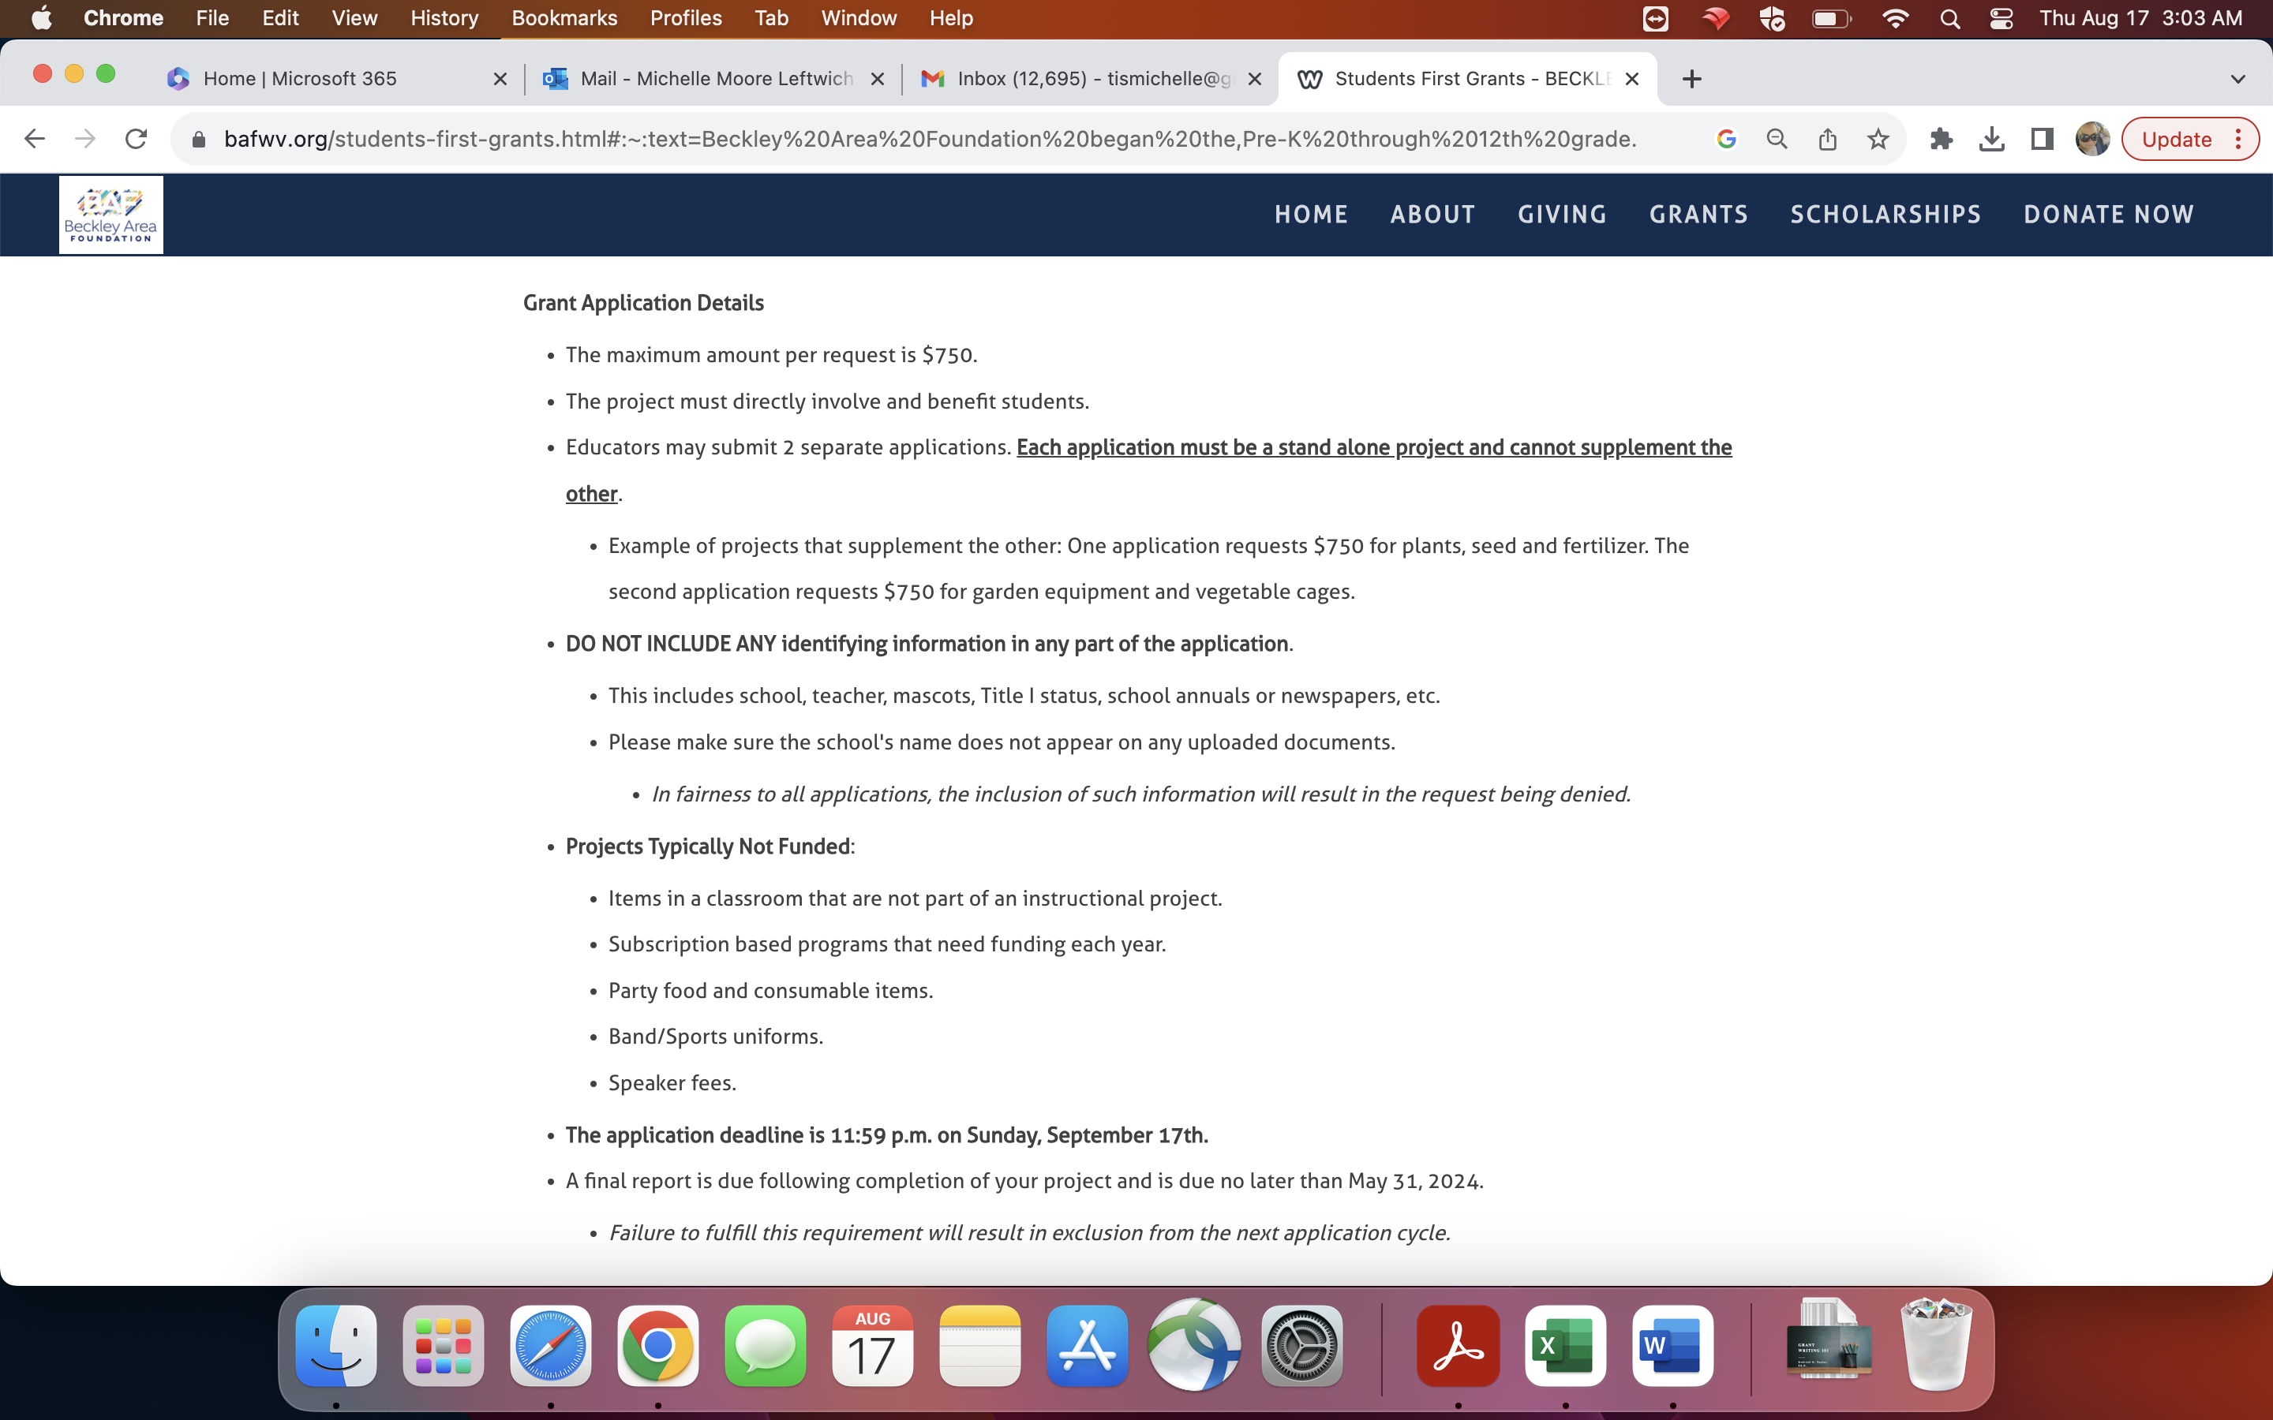

Slide 25
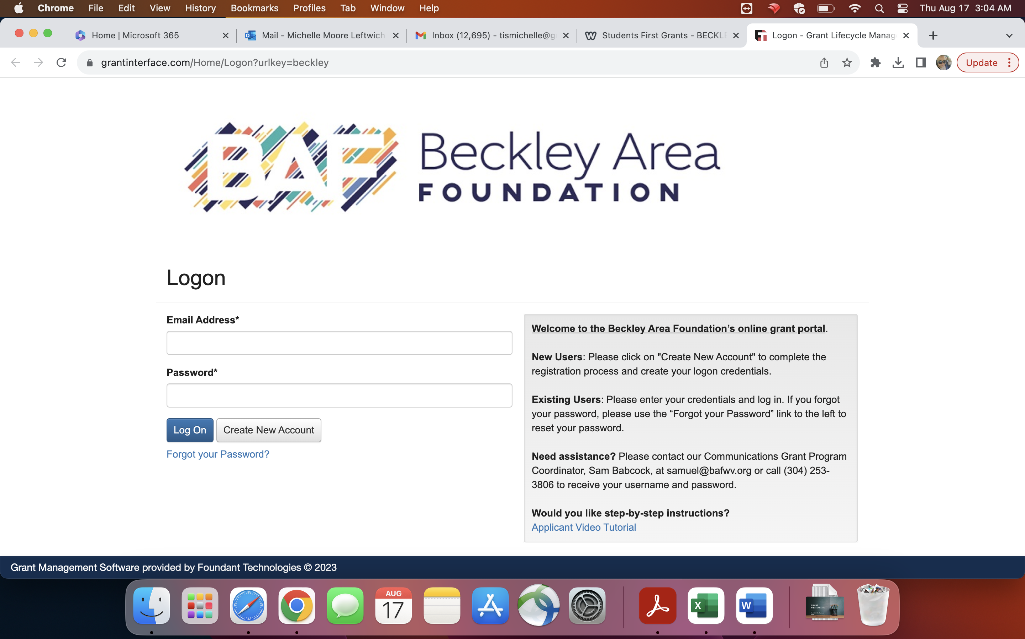

Slide 26
Notes:
Go to the https://www.bafwv.org/uploads/5/2/8/1/52817871/graphing_our_success_application.pdf to view an example of a fully funded grant award.

Slide 27
Tips for Securing Funding

Slide 28
Create a strong application
Review the request for funding and make sure you understand the application process
Follow the grant's guidelines precisely.
Include all requested documents and attachments.
Submit your application well before the deadline.
Seek feedback from peers before submitting.
Tailor each application to the specific grant's requirements.
If the grant maker provides training or live webinars attend
Secure partnerships and collaborators

Slide 29
Final tips
Grant writing is a skill that improves with practice.
Your dedication can lead to exciting opportunities for your classroom.
Stay persistent; rejection is a part of the process.
Do not apply for funding that does not align with your mission
Start exploring grants and turn your innovative ideas into reality!

